Slide 1
Programming with Python
Basic Concepts 3

Slide 2
Lesson Objectives
Modules
Packages
Try…except…finally

Slide 3
Section 1
Modules

Slide 4

Modules
What are Modules?
Modules are files containing Python definitions and statements (ex. name.py)
A module’s definitions can be imported into other modules by using “import name”
The module’s name is available as a global variable value
To access a module’s functions, type “name.function()”

Slide 5
Modules
The import Statement
import <module_name>
import <module_name> as <alt_name>
Example:
import numpy
import numpy as np

Slide 6
Modules
The from Statement
from <module_name> import <name(s)>
from <module_name> import <name> as <alt_name>
Example
from tensorflow import keras
from tensorflow import keras as K

Slide 7
Modules
Executing Modules
python name.py <arguments>
Runs code as if it was imported
Setting _name_ == “_main_” the file can be used as a script and an importable module

Slide 8
Modules
Advantages to modularizing code in a large application
Simplicity
Maintainability
Reusability
Scoping

Slide 9
Section 2
Packages

Slide 10
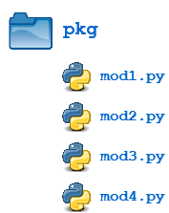
Packages
Packages allow for a hierarchical structuring of the module namespace using dot notation.
Creating a package is quite straightforward, since it makes use of the operating system’s inherent hierarchical file structure.

Slide 11

Packages
Package Initialization
If a file named __init__.py is present in a package directory, it is invoked when the package or a module in the package is imported.
This can be used for execution of package initialization code, such as initialization of package-level data.

Slide 12
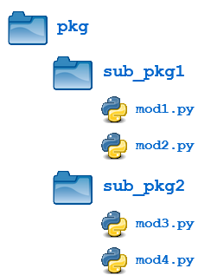
Packages
Importing * From a Package
from <package_name> import *
Subpackages
from <package_name_1>. <package_name_1.1> import *

Slide 13
Modules - Packages
Python searches modules in the following manner:
Searches in current directory
If the module is not found then searches each directory in the shell variable PYTHONPATH
If all else fails, python checks the default path which is the installation location of the python

Slide 14
Packages Management - PIP
What is pip?
Pip is a package-management system used to intall and manage software packages written in python
Pip install <package-name>

Slide 15
Packages Management - PIP
List all packages installed
Pip freeze
help("modules")

Slide 16
Section 3
Try…except…finally

Slide 17
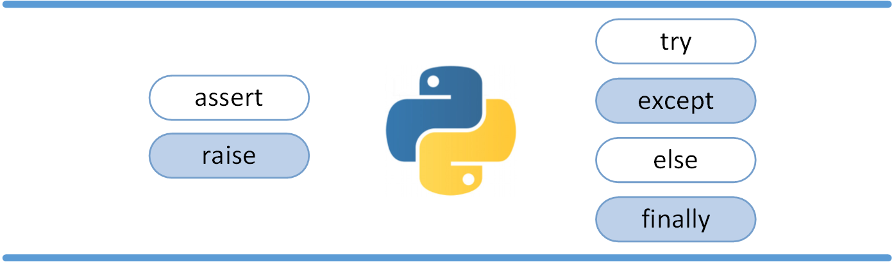
Try…except…finally
Exceptions versus Syntax Errors
Raising an Exception
The AssertionError Exception
Handling Exceptions
The else Clause

Slide 18

Try…except…finally
Exceptions versus Syntax Errors
Syntax errors occur when the parser detects an incorrect statement.

Slide 19
Try…except…finally
Raising an Exception
We can use raise to throw an exception if a condition occurs.
x = 10
if x > 5:
raise Exception('x should not exceed 5. The value of x was: {}'.format(x))

Slide 20
Try…except…finally
The AssertionError Exception
We assert that a certain condition is met. If this condition turns out to be True, then that is excellent! The program can continue. If the condition turns out to be False, you can have the program throw an AssertionError exception.
import sys
assert ('linux' in sys.platform), "This code runs on Linux only."

Slide 21
Try…except…finally
The try block lets you test a block of code for errors.
The except block lets you handle the error.
The finally block lets you execute code, regardless of the result of the try- and except blocks.

Slide 22
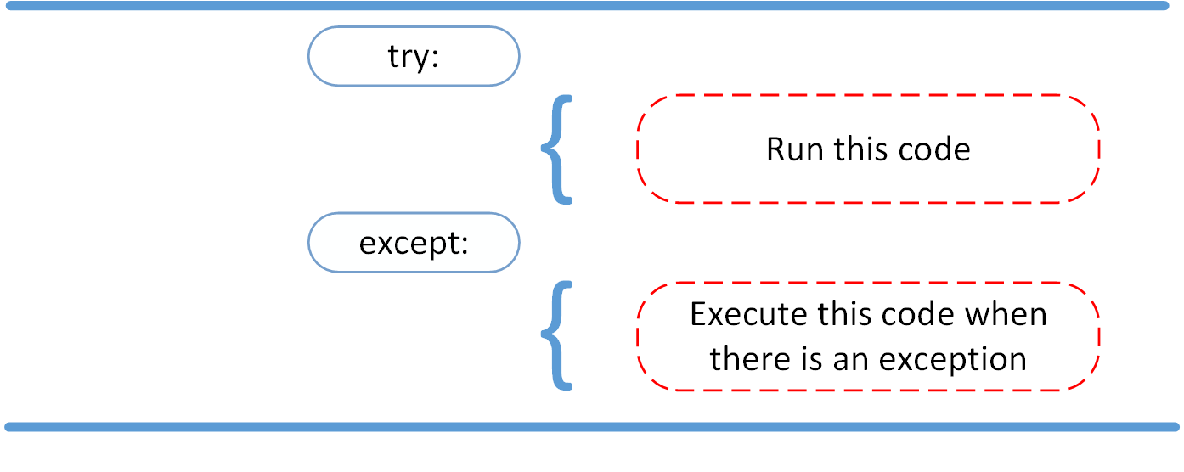
Try…except…finally
The try and except Block
The try and except block in Python is used to catch and handle exceptions.

Slide 23
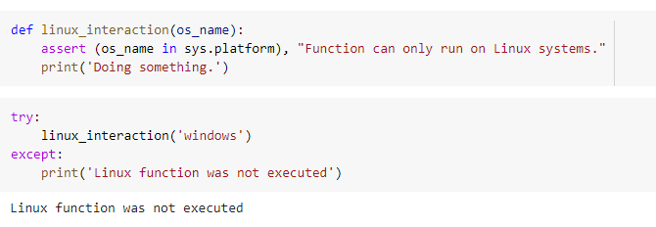
Try…except…finally
The try and except Block

Slide 24
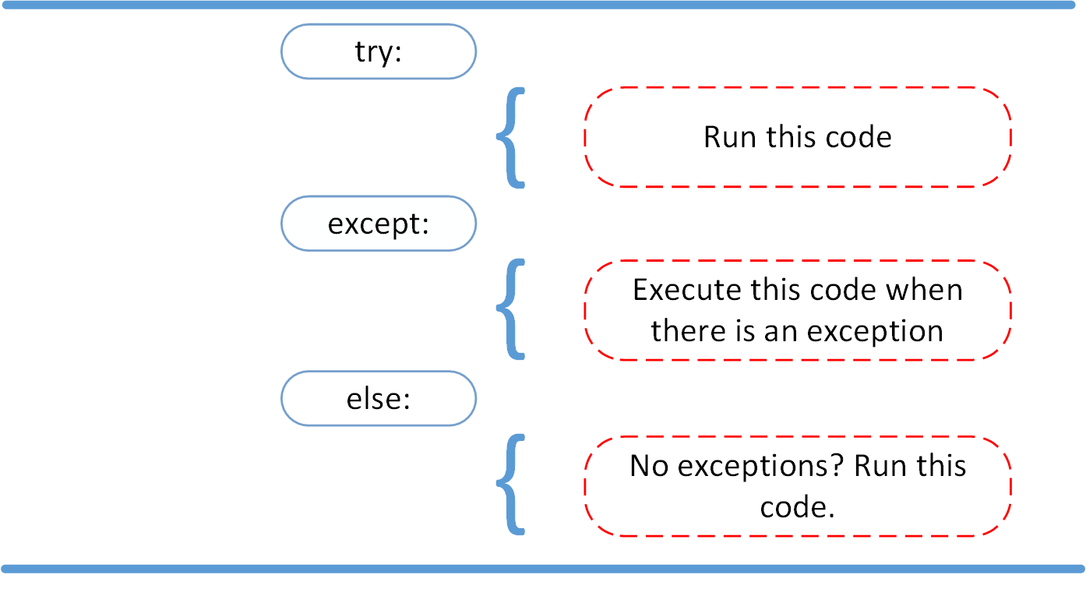
Try…except…finally
The else Clause

Slide 25
Try…except…finally
The else Clause
try:
linux_interaction('linux')
except AssertionError as error:
print(error)
else:
print('Executing the else clause.')

Slide 26
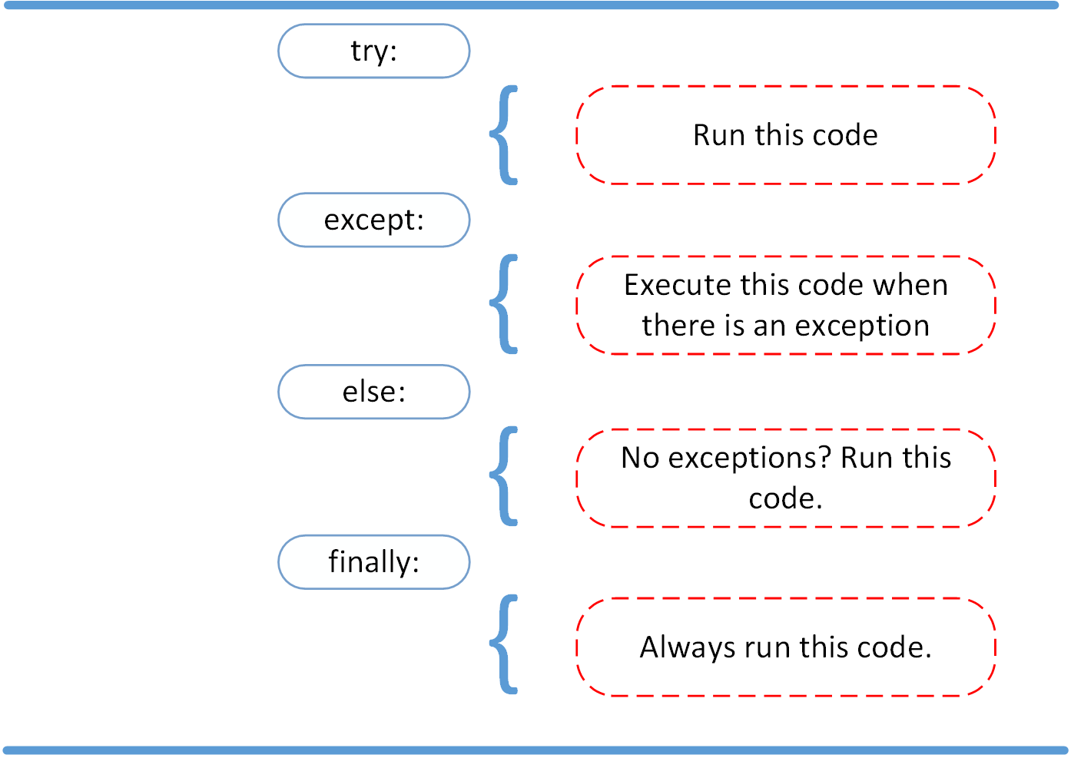
Try…except…finally
Cleaning Up After Using finally

Slide 27
Try…except…finally
Cleaning Up After Using finally
try:
linux_interaction('windows')
except AssertionError as error:
print(error)
else:
try:
with open('file.log') as file:
read_data = file.read()
except FileNotFoundError as fnf_error:
print(fnf_error)
finally:
print('Cleaning up, irrespective of any exceptions.')

Slide 28
Try…except…finally
Customizing Exception Classes
class SalaryNotInRangeError(Exception):
def __init__(self, salary, message="Salary is not in (5000, 15000) range"):
self.salary = salary
self.message = message
super().__init__(self.message)
def salary_validate(salary):
if not 5000 < salary < 15000:
raise SalaryNotInRangeError(salary)

Slide 29
Try…except…finally
Using Custom Exception Classes
try:
salary = int(input("Enter salary amount: "))
salary_validate(salary)
except SalaryNotInRangeError as sni:
print(sni.message)

Slide 30

Thank you

